Slide 1
6
Organizational Structure and Design
Copyright ©2017 Pearson Education, Inc.
6-<number>

Slide 2
Learning Outcomes
Describe six key elements in organizational design.
Identify the contingency factors that favor either the mechanistic model or the organic model of organizational design.
Compare and contrast traditional and contemporary organizational designs.
Discuss the design challenges faced by today’s organizations.
Copyright ©2017 Pearson Education, Inc.
6-<number>
Notes:
After studying this chapter, you will be able to:
Describe six key elements in organizational design.
Identify the contingency factors that favor either the mechanistic model or the organic model of organizational design.
Compare and contrast traditional and contemporary organizational designs.
Discuss the design challenges faced by today’s organizations.

Slide 3
6-1
Describe six key elements in organizational design.
Copyright ©2017 Pearson Education, Inc.
6-<number>

Slide 4
Elements of
Organizational Structure
  Work specialization
  Departmentalization
  Authority and responsibility
  Span of control
  Centralization vs. decentralization
  Formalization
Copyright ©2017 Pearson Education, Inc.
6-<number>
Notes:
Organizing is the management function that creates the organization’s structure. When managers develop or change the organization’s structure, they’re engaging in organization design, which is the process of making decisions about how specialized jobs should be, the rules to guide employees’ behaviors, and the level at which decisions will be made.
Organizing and organizational structure have undergone much change in the 80 years since the basic concepts of organization design were formulated by management writers such as Henri Fayol and Max Weber.
Let’s now look at the six basic elements of organizational structure:
Work specialization
Departmentalization
Authority and responsibility
Span of control
Centralization versus decentralization
Formalization

Slide 5
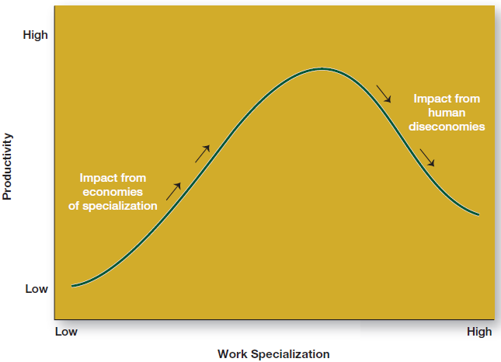
Specialization
Copyright ©2017 Pearson Education, Inc.
6-<number>
Notes:
Work specialization is the division of work activities into separate job tasks. At the Wilson Sporting Goods factory in Ada, Ohio, workers making NFL footballs specialize in job tasks—such as molding, stitching and sewing, and lacing—to increase work output.
When first introduced, specialization almost always generated higher productivity. But at some point, the human diseconomies—boredom, fatigue, stress, low productivity, poor quality, increased absenteeism, and high turnover—exceed the economic advantages, as seen here in Exhibit 6-1.
Most managers today see work specialization as an important organizing mechanism because it helps employees to be more efficient. However, managers also have to recognize its limitations.

Slide 6
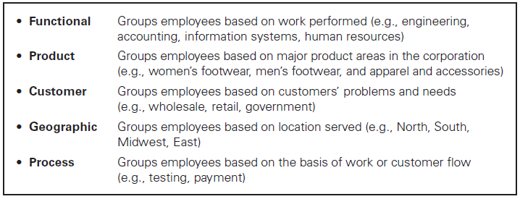
Departmentalization
Copyright ©2017 Pearson Education, Inc.
6-<number>
Notes:
Early management writers argued that common work activities needed to be grouped together to get them done in a coordinated and integrated way.
How jobs are grouped together is called departmentalization. There are five common forms of departmentalization (as seen in Exhibit 6-2), although an organization may use its own unique method.
Functional departmentalization, or grouping activities by function—such as engineering, accounting, information systems, and human resources—is one of the most popular ways of organizing the workplace. Its major advantage is that it achieves economies of scale by placing people with common skills and specializations into common units.
Product departmentalization groups employees based on a corporation’s major product areas. Each product is under the authority of a senior manager who is a specialist in, and is responsible for, everything related to his or her product line. The advantage of product grouping is that it increases accountability for product performance because all activities related to a specific product are under the direction of a single manager.
3. Employees can also be grouped by the type of customer an organization seeks to reach. For example, the sales activities in an office supply firm can be divided into three departments that serve retail, wholesale, and government customers, respectively. The assumption underlying customer departmentalization is that customers in each department have a common set of problems and needs that can best be met by specialists.
4. Another way to departmentalize is on the basis of geography or territory, which is called geographic departmentalization. The sales function might have western, southern, midwestern, and eastern regions.
5. Process departmentalization groups activities on the basis of work or customer flow. Examples of process departmentalization can be found in many states’ motor vehicle offices and in health care clinics. Units are organized around common skills needed to complete a certain process.
It is interesting to note that some companies, such as Black & Decker, organize their divisions along functional lines, their manufacturing units around processes, their sales around geographic regions, and their sales regions around customer groupings. Still other organizations use cross-functional teams, which are teams comprised of individuals from various departments who tackle complex tasks in which diverse skills are needed. Note also that today’s competitive environment has refocused the attention of management on its customers, so many organizations are placing greater emphasis on customer departmentalization.

Slide 7
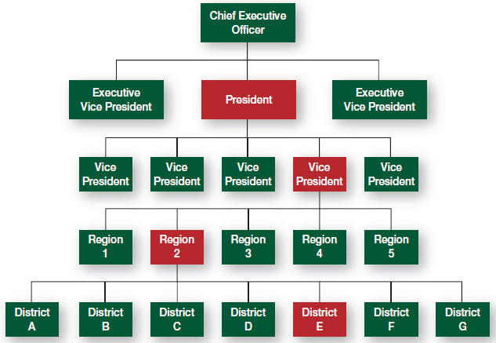
Types of Authority Relationships
Copyright ©2017 Pearson Education, Inc.
6-<number>
Notes:
When organizing work, managers need to clarify who reports to whom, which is known as the chain of command—that is, the line of authority extending from upper to lower organizational levels.
Authority refers to the rights inherent in a managerial position to give orders and expect those orders to be obeyed. Authority is a major concept discussed by the early management writers, who viewed it as the glue that held an organization together. Each management position had specific inherent rights associated with the position’s rank or title.
When managers delegate authority, they must allocate commensurate responsibility. That is, when employees are given rights they also assume a corresponding obligation to perform and be held accountable for their performance.
Early management writers distinguished between two forms of authority: line authority and staff authority. Line authority entitles a manager to direct the work of an employee according to the chain of command, which is shown here in Exhibit 6-3. In the chain of command, every manager is subject to the direction of his or her superior.
Sometimes the term ”line” is used to differentiate line managers from staff managers. In this context, line refers to managers whose organizational function contributes directly to the achievement of organizational objectives.
Whether a manager’s function is classified as line or staff depends on the organization’s objectives.

Slide 8
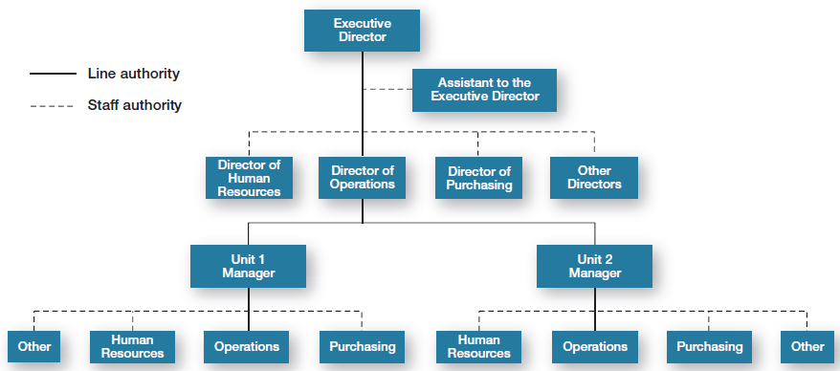
Line and Staff Authority
Copyright ©2017 Pearson Education, Inc.
6-<number>
Notes:
As organizations get larger and more complex, line managers find that they do not have the time, expertise, or resources to get their jobs done effectively. In response, they create staff authority functions to support, assist, advise, and generally reduce some of their informational burdens.
For example, if a hospital administrator cannot effectively purchase all the supplies the hospital needs, the administrator creates a purchasing department, which is a staff department. Exhibit 6-4, seen here, illustrates how line and staff authority relate.

Slide 9

Unity of Command
A structure in which each employee reports to only one manager
Copyright ©2017 Pearson Education, Inc.
6-<number>
Notes:
But this structure begs the question, “How many bosses does an employee report to?” Traditionally, the unity of command structure, in which each employee reports to only one manager, was the norm. In instances when the unity of command had to be violated, a clear separation of activities and a supervisor responsible for each was always explicitly designated.
Today, advances in technology allow employees access to company information and communication company-wide without going through the formal chain of command.

Slide 10
How Do Authority and Power Differ?
Authority:
a right whose legitimacy is based on an authority figure’s position in the organization; it goes with the job.
Power:
an individual’s ability to influence decisions.
Copyright ©2017 Pearson Education, Inc.
6-<number>
Notes:
Early management writers assumed that the rights inherent in one’s position in an organization were the sole source of influence and that the higher a manager’s position in the organization, the more influence he or she had.
Today, however, management recognizes that you don’t have to be a manager to have power.
Authority and power are often considered the same thing, but they’re not. Authority is a right and its legitimacy is based on an authority figure’s position in the organization. Power, on the other hand, refers to an individual’s capacity to influence decisions.

Slide 11
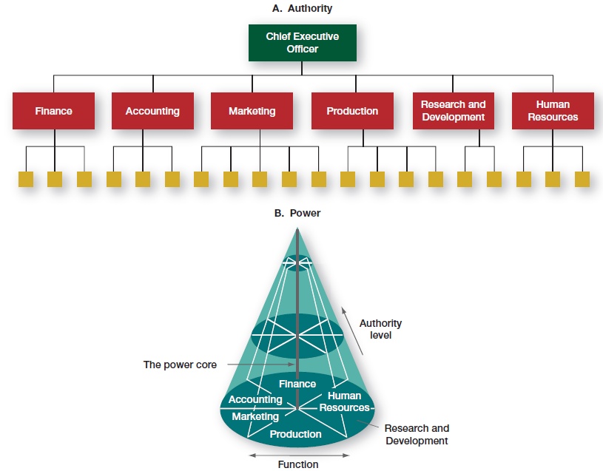
Power Versus Authority
Copyright ©2017 Pearson Education, Inc.
6-<number>
Notes:
Exhibit 6-5 depicts the difference between authority and power. The boxes in Part A portray authority. Each horizontal grouping represents a functional area in which the authority applies. The influence one holds in the organization is defined by the vertical dimension in the structure. The higher one is in the organization, the greater one’s authority.
Power, on the other hand, is a three-dimensional concept (as shown by the cone in Part B of Exhibit 6-5). It includes not only the functional and hierarchical dimensions but also a third dimension called centrality.
Power is made up of both one’s vertical position and one’s distance from the organization’s power core or center. If the cone in Exhibit 6-5 were an organization, the center of the cone would be the power core. The closer one is to the power core, the more influence one has on decisions.
In fact, the existence of a power core is the only difference between A and B in Exhibit 6-5. The top of the cone corresponds to the top of the hierarchy, the middle of the cone to the middle of the hierarchy, and so on. Similarly, the functional groups in A become wedges in the cone. Each wedge represents a functional area.
The cone analogy acknowledges two facts:
The higher one moves in an organization (an increase in authority), the closer one moves to the power core; and
It’s not necessary to have authority to wield power because one can move horizontally inward toward the power core without moving up. For instance, as gatekeepers for their bosses, assistants often are powerful in a company even though they have little authority.

Slide 12
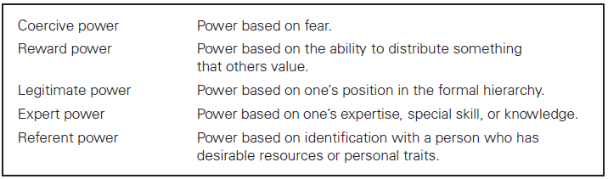
Types of Power
Copyright ©2017 Pearson Education, Inc.
6-<number>
Notes:
Researchers French and Raven have identified five types, or bases, of power: coercive, reward, legitimate, expert, and referent. These types are summarized here in Exhibit 6-6.
What kind of power does an employee with years of institutional knowledge have? What kind of authority does a prison board have?

Slide 13
Span of Control
Effective and efficient span depends on:
Employee experience and training (more they have, larger span)
Similarity of employee tasks (more similarity, larger span)
Complexity of those tasks (more complex, smaller span)
Copyright ©2017 Pearson Education, Inc.
6-<number>
Notes:
Next comes the question of how many employees a manager efficiently and effectively can supervise.
Increasingly, contingency variables are influencing this span. For example, the more training and experience employees have, the less direct supervision they need. Other contingency variables include similarity of employee tasks, the complexity of those tasks, the physical proximity of employees, the degree to which standardized procedures are in place, the sophistication of the organization’s management information system, the strength of the organization’s value system, and the manager’s preferred managing style.

Slide 14
Centralization and Decentralization
Centralization:
decision making takes place at upper levels of the organization.
Decentralization:
lower-level managers provide input or actually make decisions.
Copyright ©2017 Pearson Education, Inc.
6-<number>
Notes:
When organizing, managers need to ask, “At what level are decisions made?”
Centralization is the degree to which decision making takes place at upper levels of the organization. Decentralization is the degree to which lower-level managers provide input or actually make decisions.
Traditionally, organizations were structured in a pyramid, with power and authority concentrated near the top.
Today’s organizations are more complex and responsive to dynamic changes in their environments, so many managers believe that decisions need to be made by those individuals closest to the problems. Notice, however, that decentralization doesn’t imply that top-level managers no longer make decisions.

Slide 15
Formalization
How standardized an organization’s jobs are and the extent to which employee behavior is guided by rules and procedures
Copyright ©2017 Pearson Education, Inc.
6-<number>
Notes:
Formalization refers to how standardized an organization’s jobs are and the extent to which employee behavior is guided by rules and procedures. In highly formalized organizations, there are explicit job descriptions, numerous organizational rules, and clearly defined procedures covering work processes.
Although some formalization is necessary for consistency and control, today many organizations rely less on strict rules and standardization to guide and regulate employee behavior than they did in the past. Employees are given the latitude, for example, to accommodate a customer dropping off a roll of film to develop a half-hour after the store’s cutoff time. With low formalization, the employee could calculate that she can develop the film before store closing and thus, demonstrate good customer service and bring in revenue.
Of course, there will always be organizational rules that are important for employees to follow—and these rules should be explained so employees understand why it’s important to adhere to them.

Slide 16
6-2
Identify the contingency factors that favor either the mechanistic model or the organic model of organizational design.
Copyright ©2017 Pearson Education, Inc.
6-<number>

Slide 17
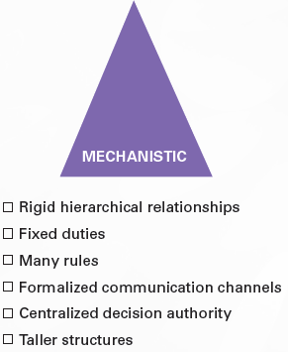
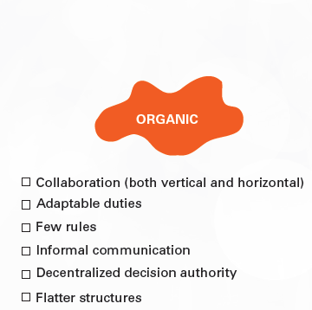
Models of
Organizational Design
Copyright ©2017 Pearson Education, Inc.
6-<number>
Notes:
How an organization is structured depends on contingency variables such as strategy, size, technology, and environment. Let’s take a look at the two generic organization structure models shown here.
The mechanistic organization (or bureaucracy) – Rigid and tightly controlled structure that combines traditional aspects of all six elements of organization structure. Combines traditional aspects of all six elements of organization structure: high specialization, rigid departmentalization, clear chain of command, narrow spans of control leading to taller structure, centralization, and high formalization.
In contrast, the organic organization – Highly adaptive and flexible structure, which allows it to change rapidly as required. Collaboration (both vertical and horizontal), adaptable duties, few rules, informal communication, decentralized decision authority, and wider spans of control leading to flatter structures.

Slide 18
Strategy and Structure
Certain structural designs work best with different organizational strategies:
Simple strategy Simple structure
Elaborate strategy More complex structure
Copyright ©2017 Pearson Education, Inc.
6-<number>
Notes:
Based on the work of Alfred Chandler. It believes goals are an important part of an organization’s strategies and that structure should facilitate goal achievement.
Simple strategy means simple structure and elaborate strategy means more complex structure.
Certain structural designs work best with different organizational strategies.
Passionate pursuit of innovation is associated with an organic structure, while a passionate pursuit of cost control is associated with a mechanistic organization.

Slide 19
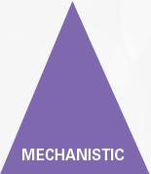

Size and Structure
Organic:
less than 2,000 employees can be organic.
Mechanistic:
more than 2,000 employees makes organizations to become more
Mechanistic.
Copyright ©2017 Pearson Education, Inc.
6-<number>
Notes:
There is considerable evidence that size (number of employees) affects structure; the magic number seems to be 2,000 employees.
LARGE organizations (> 2,000 employees)—mechanistic. When an organization reaches this number, size is less influential; adding more employees has little impact as structure is already fairly mechanistic.
Adding a significant number of new employees to a smaller organization that has a more organic structure will force it to become more mechanistic.

Slide 20

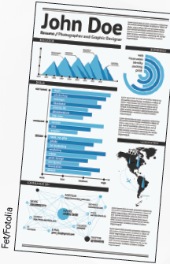

Technology and Structure
Copyright ©2017 Pearson Education, Inc.
6-<number>
Notes:
Every organization uses some form of technology to convert its inputs into outputs. For example:
Your smartphone or tablet: standardized assembly line.
Your resume: custom design and print.
Your bottle of ibuprofen: continuous flow of production process.

Slide 21
Environment and Structure
Stable environment: mechanistic structure
Dynamic environment: organic structure
Copyright ©2017 Pearson Education, Inc.
6-<number>
Notes:
Environment is a constraint on managerial discretion. Environment also has a major effect on an organization’s structure:
— Stable environment: Mechanistic structure
— Dynamic/uncertain environment: Organic structure
It helps explain why so many managers today have restructured their organizations to be lean, fast, and flexible.

Slide 22
6-3
Compare and contrast traditional and contemporary organizational designs.
Copyright ©2017 Pearson Education, Inc.
6-<number>

Slide 23
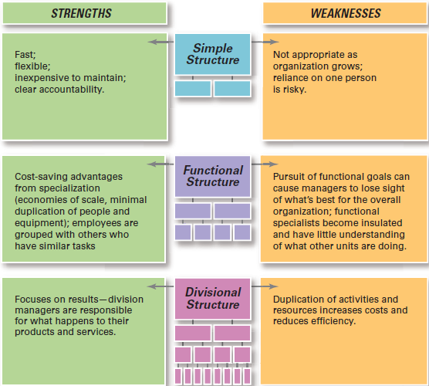
Traditional
Organizational Designs
Copyright ©2017 Pearson Education, Inc.
6-<number>
Notes:
In making structural decisions, managers can choose either a traditional or contemporary design.
Within traditional organizational design, there are three structures: simple, functional, and divisional, all of which tend to be mechanistic in nature. Here in Exhibit 6-9 we see a summary of the strengths and weaknesses of each.
Since most companies start as entrepreneurial ventures, they use a simple structure, which is an organizational design with low departmentalization, wide spans of control, authority centralized in a single person, and little formalization.
The simple structure is most widely used in smaller businesses and it’s fast, flexible, inexpensive to maintain, and has clear accountability. However, as an organization grows, there are few policies to guide operations, which creates information overload at the top and slows decision making.
As more employees are added, most small businesses tend to become more specialized and formalized. Rules and regulations are introduced, work becomes specialized, departments are created, levels of management are added, and the organization becomes increasingly bureaucratic.
Two of the most popular bureaucratic design options grew out of functional and product departmentalization. They are called the functional and divisional structures.

Slide 24
Functional Structure
An organizational design that groups similar or related occupational specialties
Copyright ©2017 Pearson Education, Inc.
6-<number>
Notes:
A functional structure is an organizational design that groups similar or related occupational specialties. For example, Revlon, Inc. is organized around the functions of operations, finance, human resources, and product research and development.
The strength of the functional structure is the advantages of economies of scale, minimal duplication of personnel and equipment, and more satisfied employees who speak the same language as their peers.
The most obvious weakness of the functional structure is that the organization frequently loses sight of its best interests in the pursuit of functional goals. No single function is totally responsible for results, so members within individual functions become insulated and have little understanding of what people in other functions are doing.

Slide 25
Divisional Structure
An organizational structure made up
of separate business units or divisions
Copyright ©2017 Pearson Education, Inc.
6-<number>
Notes:
The divisional structure is an organizational structure made up of separate business units or divisions. Each division has limited autonomy and has a division manager who has authority over his or her unit and is responsible for performance. In divisional structures, the parent corporation typically acts as an external overseer to coordinate and control the various divisions, and often provides such support services as financial and legal.
The chief advantage of the divisional structure is that it focuses on results. Division managers have full responsibility for a product or service. The divisional structure also frees the headquarters staff from day-to-day operating details so that they can focus on long-term and strategic planning.
The major disadvantage of the divisional structure is duplication of activities and resources. Each division, for instance, may have a marketing research department. Because of the duplication of functions, the organization’s costs increase and efficiency decreases.

Slide 26
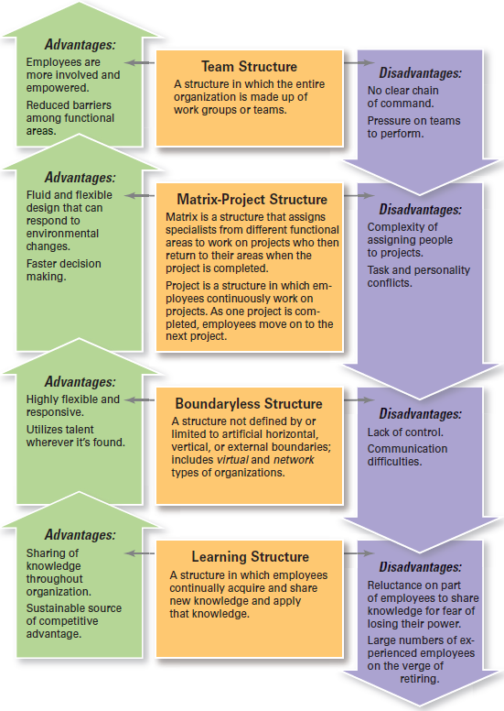
Contemporary Organizational Design
Copyright ©2017 Pearson Education, Inc.
6-<number>
Notes:
Because managers find that the traditional designs often aren’t responsive enough to today’s increasingly dynamic and complex environment, they find creative, more organic ways to structure and organize work.
As we see summarized here in Exhibit 6-10:
In team-based structures, the entire organization is made up of work teams that do the organization’s work.
Matrix and project structures assign specialists from different functional departments to work on projects led by a project manager.
Boundaryless structures are organizations with designs that are not defined by, or limited to, the horizontal, vertical, or external boundaries imposed by a predefined structure.

Slide 27
Team Structure
A structure in which the entire organization is made up of work teams that do the organization’s work
Copyright ©2017 Pearson Education, Inc.
6-<number>
Notes:
Larry Page and Sergey Brin, co-founders of Google, have created a corporate structure that “tackles most big projects in small, tightly focused teams.”
In this team structure, employee empowerment is crucial because there is no line of managerial authority from top to bottom. Instead, employee teams design and work in the way they think is best, but are held responsible for all work performance results in their respective areas. In large organizations, the team structure complements what is typically a functional or divisional structure to allow the organization to have the efficiency of a bureaucracy with the flexibility of teams.
For instance, companies such as Amazon, Boeing, Hewlett-Packard, and Xerox extensively use employee teams to improve productivity. Note that employees must be trained to work on teams, receive cross-functional skills training, and be compensated accordingly. Without a properly implemented team-based pay plan, many of the benefits of a team structure could be lost.

Slide 28
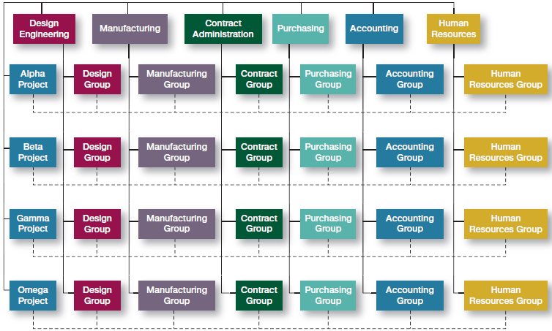
Matrix and Project Structures
Copyright ©2017 Pearson Education, Inc.
6-<number>
Notes:
Other popular contemporary designs are the matrix and project structures. In the matrix structure, specialists from different functional departments work together to complete an assigned project. When it is accomplished, they return to their functional departments.
Another unique aspect of the matrix structure is that it creates a dual chain of command since employees have two managers who share authority: their functional area manager and their product or project manager.
As shown here in Exhibit 6-11, the project manager has authority over the functional members who are part of his or her project team in areas related to the project’s goals. However, any decisions about promotions, salary recommendations, and annual reviews typically remain the functional manager’s responsibility. To work effectively, both managers have to communicate regularly, coordinate work demands, and resolve conflicts together.
The primary strength of the matrix is that it can facilitate coordination of multiple complex and interdependent projects while still retaining the economies that result from keeping functional specialists grouped together.
The major disadvantages of the matrix are the confusion it creates and its propensity to foster power struggles. Dispensing with the chain of command and unity of command principles significantly increases confusion over who reports to whom, which triggers power struggles.

Slide 29
Project Structure
A structure in which employees continuously work on projects
Copyright ©2017 Pearson Education, Inc.
6-<number>
Notes:
Instead of a matrix structure, many organizations are using a project structure, in which employees continuously work on projects. Unlike the matrix, a project structure has no formal departments to which employees return at the completion of a project. Instead, employees take their specific skills, abilities, and experiences to other projects. Additionally, all work in project structures is performed by teams of employees.

Slide 30
Boundaryless Organizations
An organization whose design is not imposed by a predefined structure
Copyright ©2017 Pearson Education, Inc.
6-<number>
Notes:
Another contemporary organizational design is the boundaryless organization, which is an organization with a design that is not imposed by a predefined structure.
Former GE chairman Jack Welch coined the term “boundaryless” because he wanted to eliminate vertical and horizontal boundaries within GE and break down external barriers between the company and its customers and suppliers. In fact, many of today’s most successful organizations find that they operate most effectively by remaining flexible and unstructured.
There are two types of boundaries:
Internal boundaries are the horizontal ones imposed by work specialization and departmentalization, and the vertical ones that separate employees into organizational levels and hierarchies.
External boundaries are those that separate the organization from its customers, suppliers, and other stakeholders. To minimize or eliminate these boundaries, managers might use virtual or network structural designs.
A virtual organization consists of a small core of full-time employees and outside specialists temporarily hired as needed. By relying on freelancers, an organization enjoys a network of talent without unnecessary overhead and structural complexity.
A network organization (or modular organization) uses its own employees to do some work activities and networks of outside suppliers to provide other needed product components or work processes.
For example, at Penske Truck Leasing, dozens of business processes—such as securing permits and titles, entering data from drivers’ logs, and processing data for tax filings and accounting—have been outsourced to Mexico and India.

Slide 31
6-4
Discuss the design challenges faced by today’s organizations.
Copyright ©2017 Pearson Education, Inc.
6-<number>

Slide 32

Current Organizational Design Challenges
Keeping employees connected
Managing global structural issues
Building a learning organization
Designing flexible work arrangements
Copyright ©2017 Pearson Education, Inc.
6-<number>
Notes:
As managers seek organizational designs that best support and facilitate employees to work efficiently and effectively, they face such challenges as:
Keeping employees connected.
Managing global structural issues.
Building a learning organization.
Designing flexible work arrangements.
Keeping widely dispersed and mobile employees connected to the organization and more productive is a major structural design challenge. In the last decade, technology has provided a variety of solutions to connecting remote employees, such as:
Handheld devices to log into corporate databases and company intranets.
Videoconferencing.
Key fobs with changing encryption codes that let employees access email and company data from any computer.
Cell phones that switch seamlessly between cellular networks and corporate Wi-Fi connections.
There are also global differences in organizational structures. Researchers have concluded that the structures and strategies of organizations worldwide are similar, although the behavior within them maintains a cultural uniqueness.
This means that managers need to think about the cultural implications of certain design elements. For instance, one study showed that formalization—rules and bureaucratic mechanisms—may be more important in less economically developed countries but less important in more economically developed countries where employees may have higher levels of professional education and skills.

Slide 33
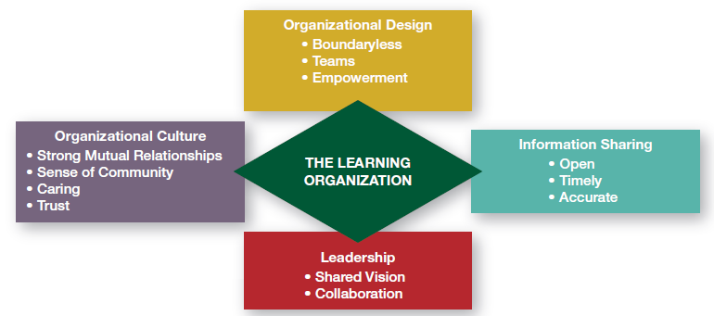
A Learning Organization
Copyright ©2017 Pearson Education, Inc.
6-<number>
Notes:
Another challenge facing managers is how to build a learning organization, which is an organizational mindset or philosophy that has significant design implications.
In a learning organization, employees continually acquire and share new knowledge and apply that knowledge when making decisions or performing their work. Some theorists say this may be the only sustainable source of competitive advantage.
As we see in Exhibit 6-12, the important characteristics of a learning organization revolve around organizational design, information sharing, leadership, and culture.
Leadership plays an important role as an organization moves toward becoming a learning organization. Leaders should facilitate the creation of a shared vision for the organization’s future and keep organizational members working toward that vision. They should also support and encourage the collaborative environment that’s critical to learning.
Finally, the organizational culture is an important aspect of a learning organization, where everyone agrees on a shared vision and recognizes the inherent relationships among the organization’s processes, activities, functions, and external environment. Organizational culture also fosters a strong sense of community, caring, and trust.

Slide 34

Flexible Work Arrangements
Telecommuting
Compressed workweek
Flextime
Job Sharing
Contingent workers
Copyright ©2017 Pearson Education, Inc.
6-<number>
Notes:
Thanks to technology, work can now be done anywhere and anytime. As organizations adapt their structural designs to these new realities, we see more of them adopting flexible working arrangements that exploit the power of technology and give them the flexibility to deploy employees when and where needed.
Some different types of flexible work arrangements including telecommuting; compressed workweeks, flextime, and job sharing; and contingent workforce.
Telecommuting is a work arrangement in which employees work at home and are linked to the workplace by computer. This arrangement saves the organization overhead and allows employees to save on commuting expenses and time. In this arrangement, managers might be concerned about supervising the productivity of remote employees, keeping employees connected socially, and the security of business information.
Organizations sometimes find that they need to restructure work using other flexible work arrangements, such as a compressed workweek in which employees work more hours per day but fewer days per week. The most common arrangement is four 10-hour days.
Another alternative is flextime (also known as flexible work hours), which is a scheduling system in which employees are required to work a specific number of hours a week but are free to vary those hours within certain limits.
Another type of job scheduling is called job sharing, which is the practice of having two or more people split a full-time job. Organizations might offer job sharing to professionals who want to work but don’t want the demands of a full-time position. Many companies use job sharing during economic downturns to avoid employee layoffs.
The labor force has already begun shifting away from traditional full-time jobs towards contingent workers—temporary, freelance, or contract workers whose employment is contingent upon demand for their services. In today’s economy, many organizations have responded by converting full-time permanent jobs into contingent jobs. It’s predicted that by the end of the next decade the number of contingent employees will grow from 30 percent to about 40 percent of the workforce.
No matter what structural design managers choose for their organizations, the design should help employees do their work in the best, most efficient, and most effective way they can.

